Slide 1



Absenteeism Analysis using Pandas
Project by: Saransh Gilhotra
www.saranshgilhotra.ca/projects

Slide 2
Introduction:
Problem Statement:
The absence from work during normal working hours results in temporary incapacity to execute regular work activities.
This absenteeism impacts overall productivity rates of the organization.
2. Objective:
To help business stakeholders understand and address absenteeism to preserve high productivity rates.

Slide 3
Continue…
3. Data Source:
The project uses a raw dataset in CSV format containing records of employees including distance to work, reason for absence, age, transportation expense, body mass index, pets.
4. Data Preprocessing Goals:
Ensure the raw dataset is transformed into meaningful quantitative information.
Clean the data to handle missing data and reorganize it for comprehensibility.
5. Steps in Data Preprocessing:
Load the Data.
Explore the Data.
Handle Missing Data.

Slide 4
Continue…
Remove Mistakes.
Data Transformation
Reorganize Data
6. Outcome:
A clean and organized dataset ready for analysis.
Insights from the data to help stakeholders make informed decisions to improve employee attendance and productivity

Slide 5
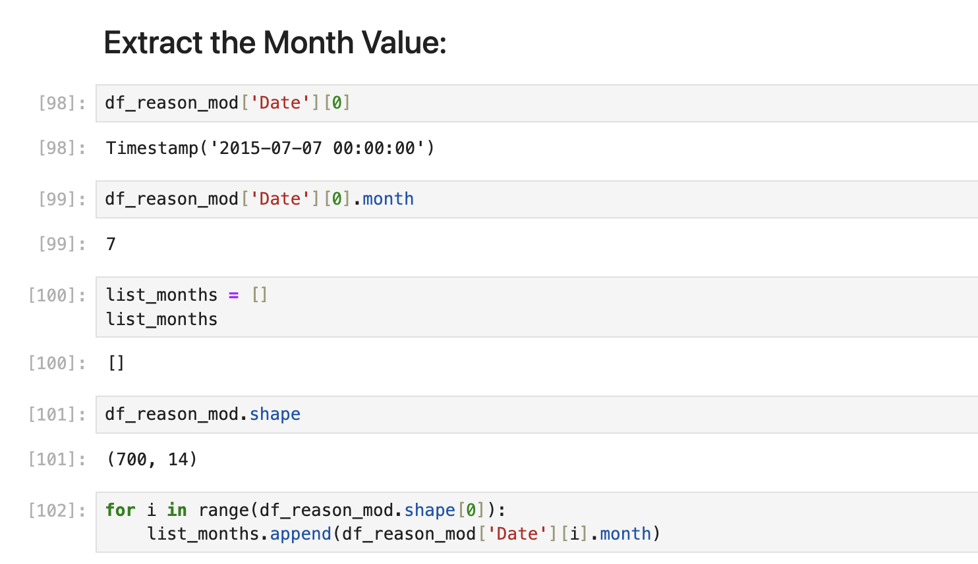
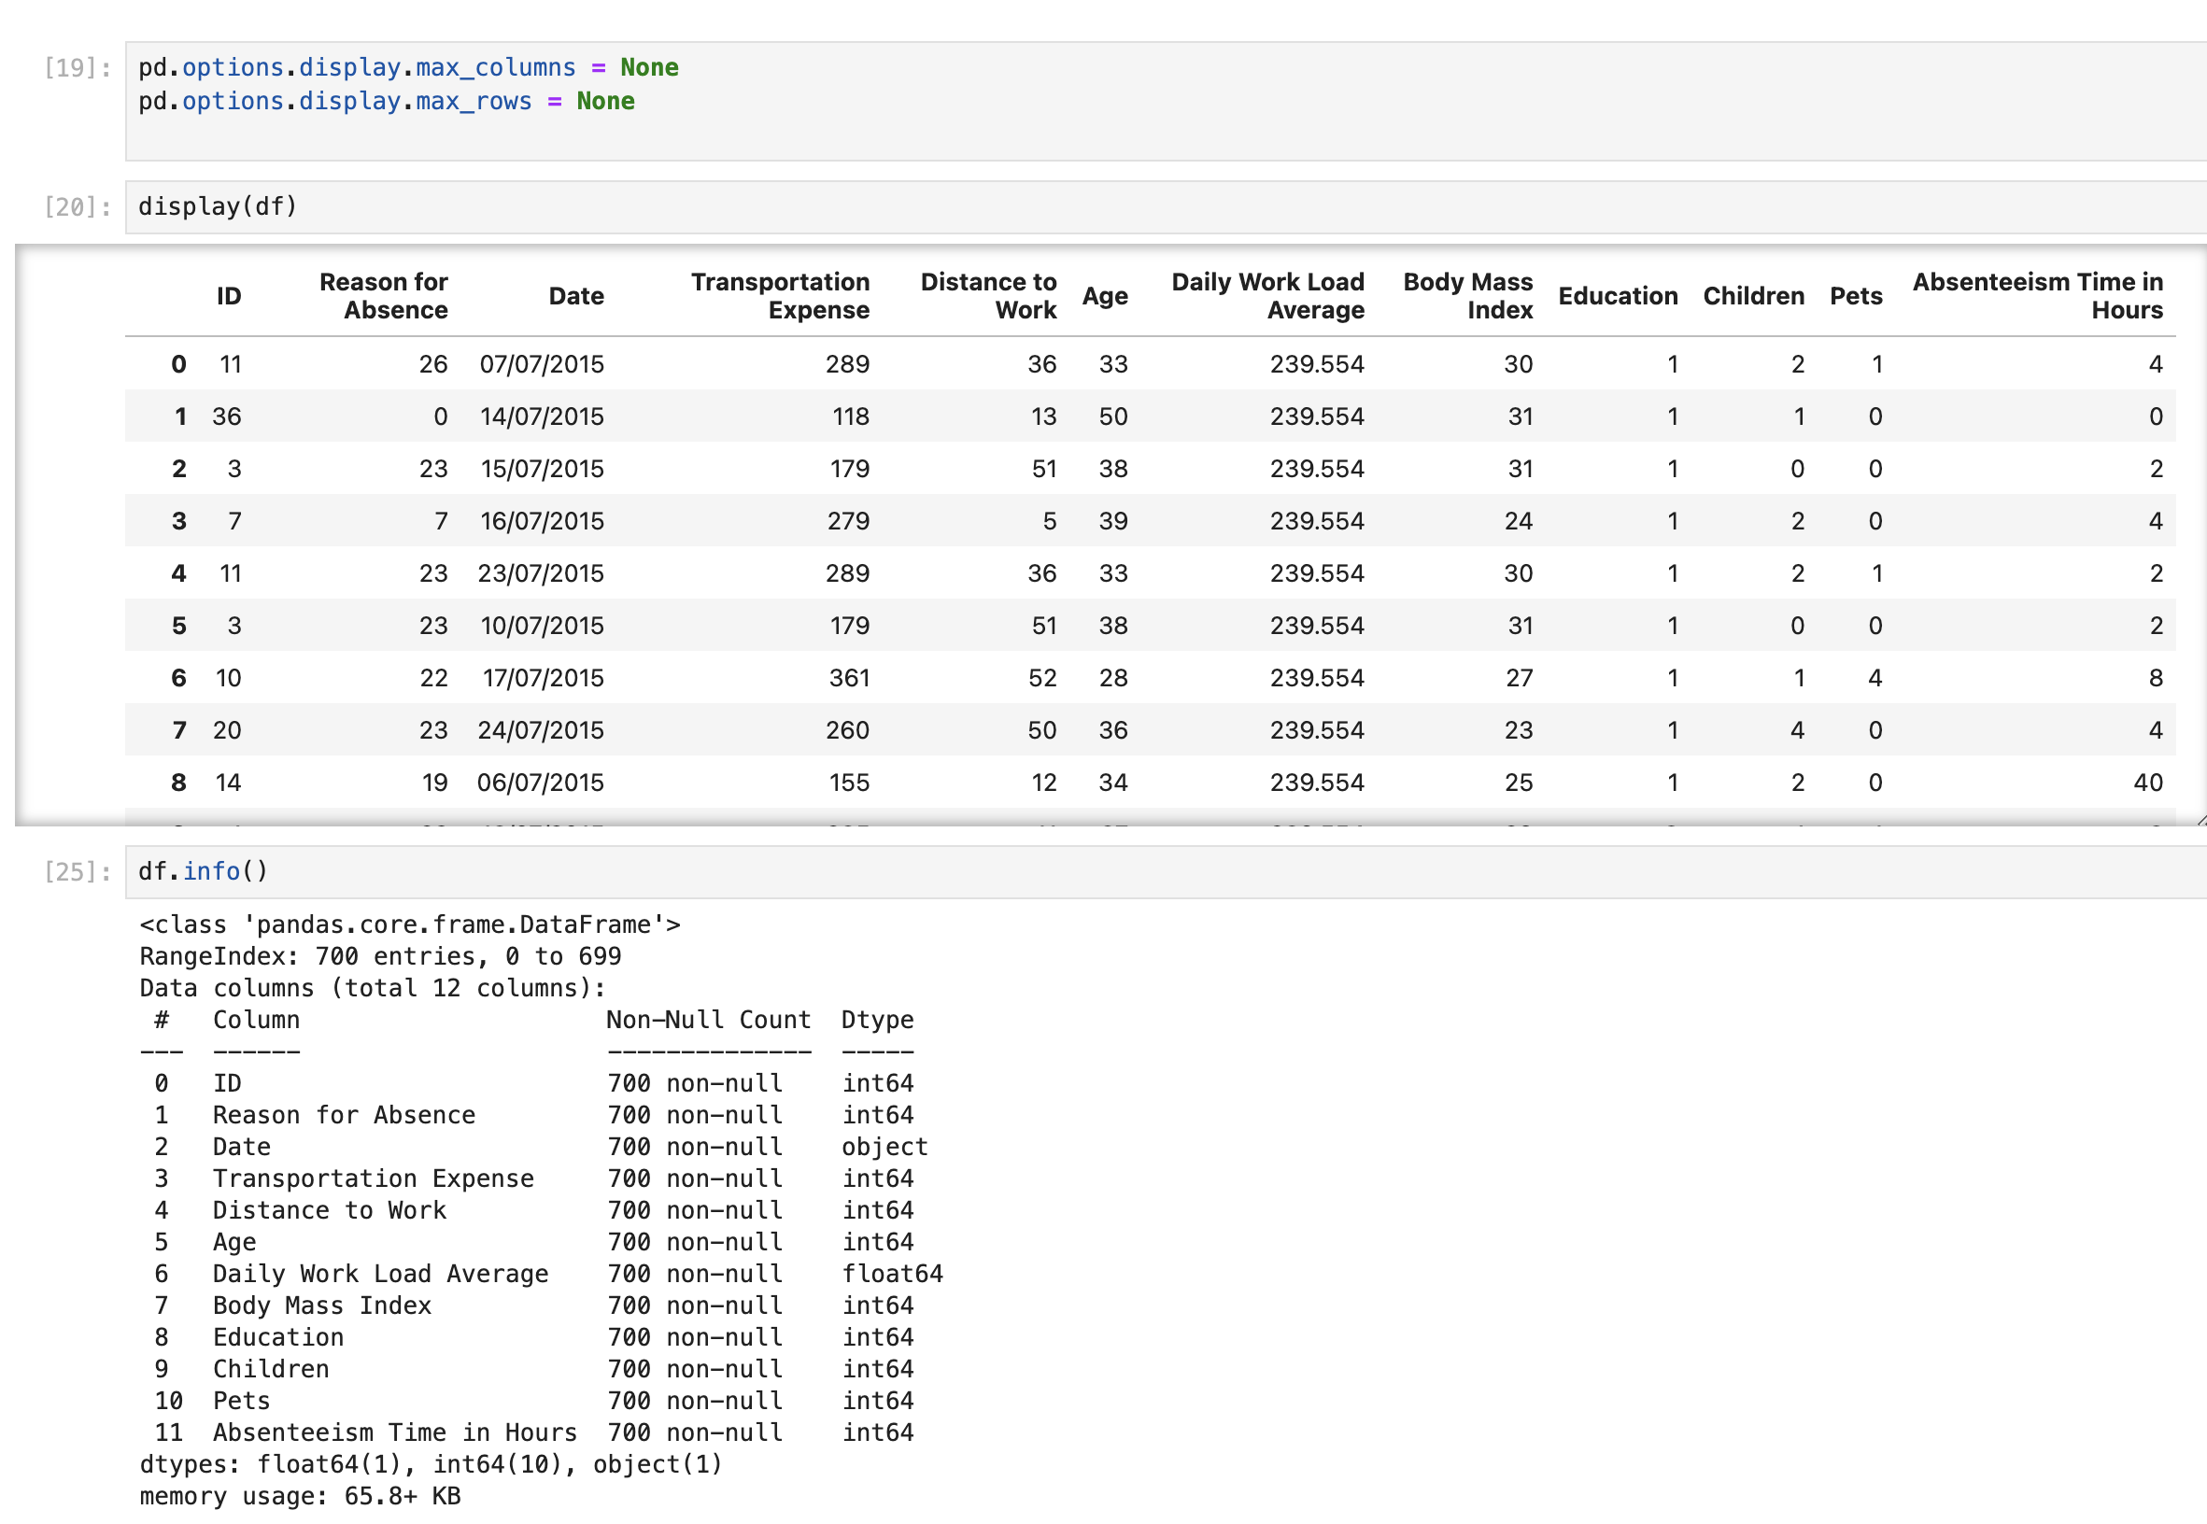
Glimpses into Data Analysis: Jupyter Notebook Screenshots

Slide 6
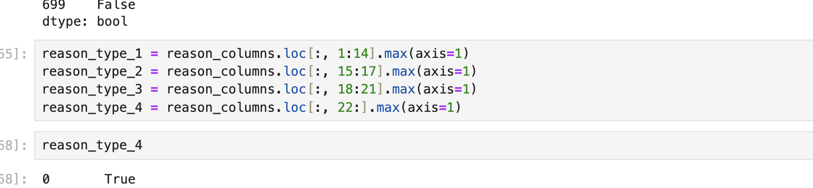
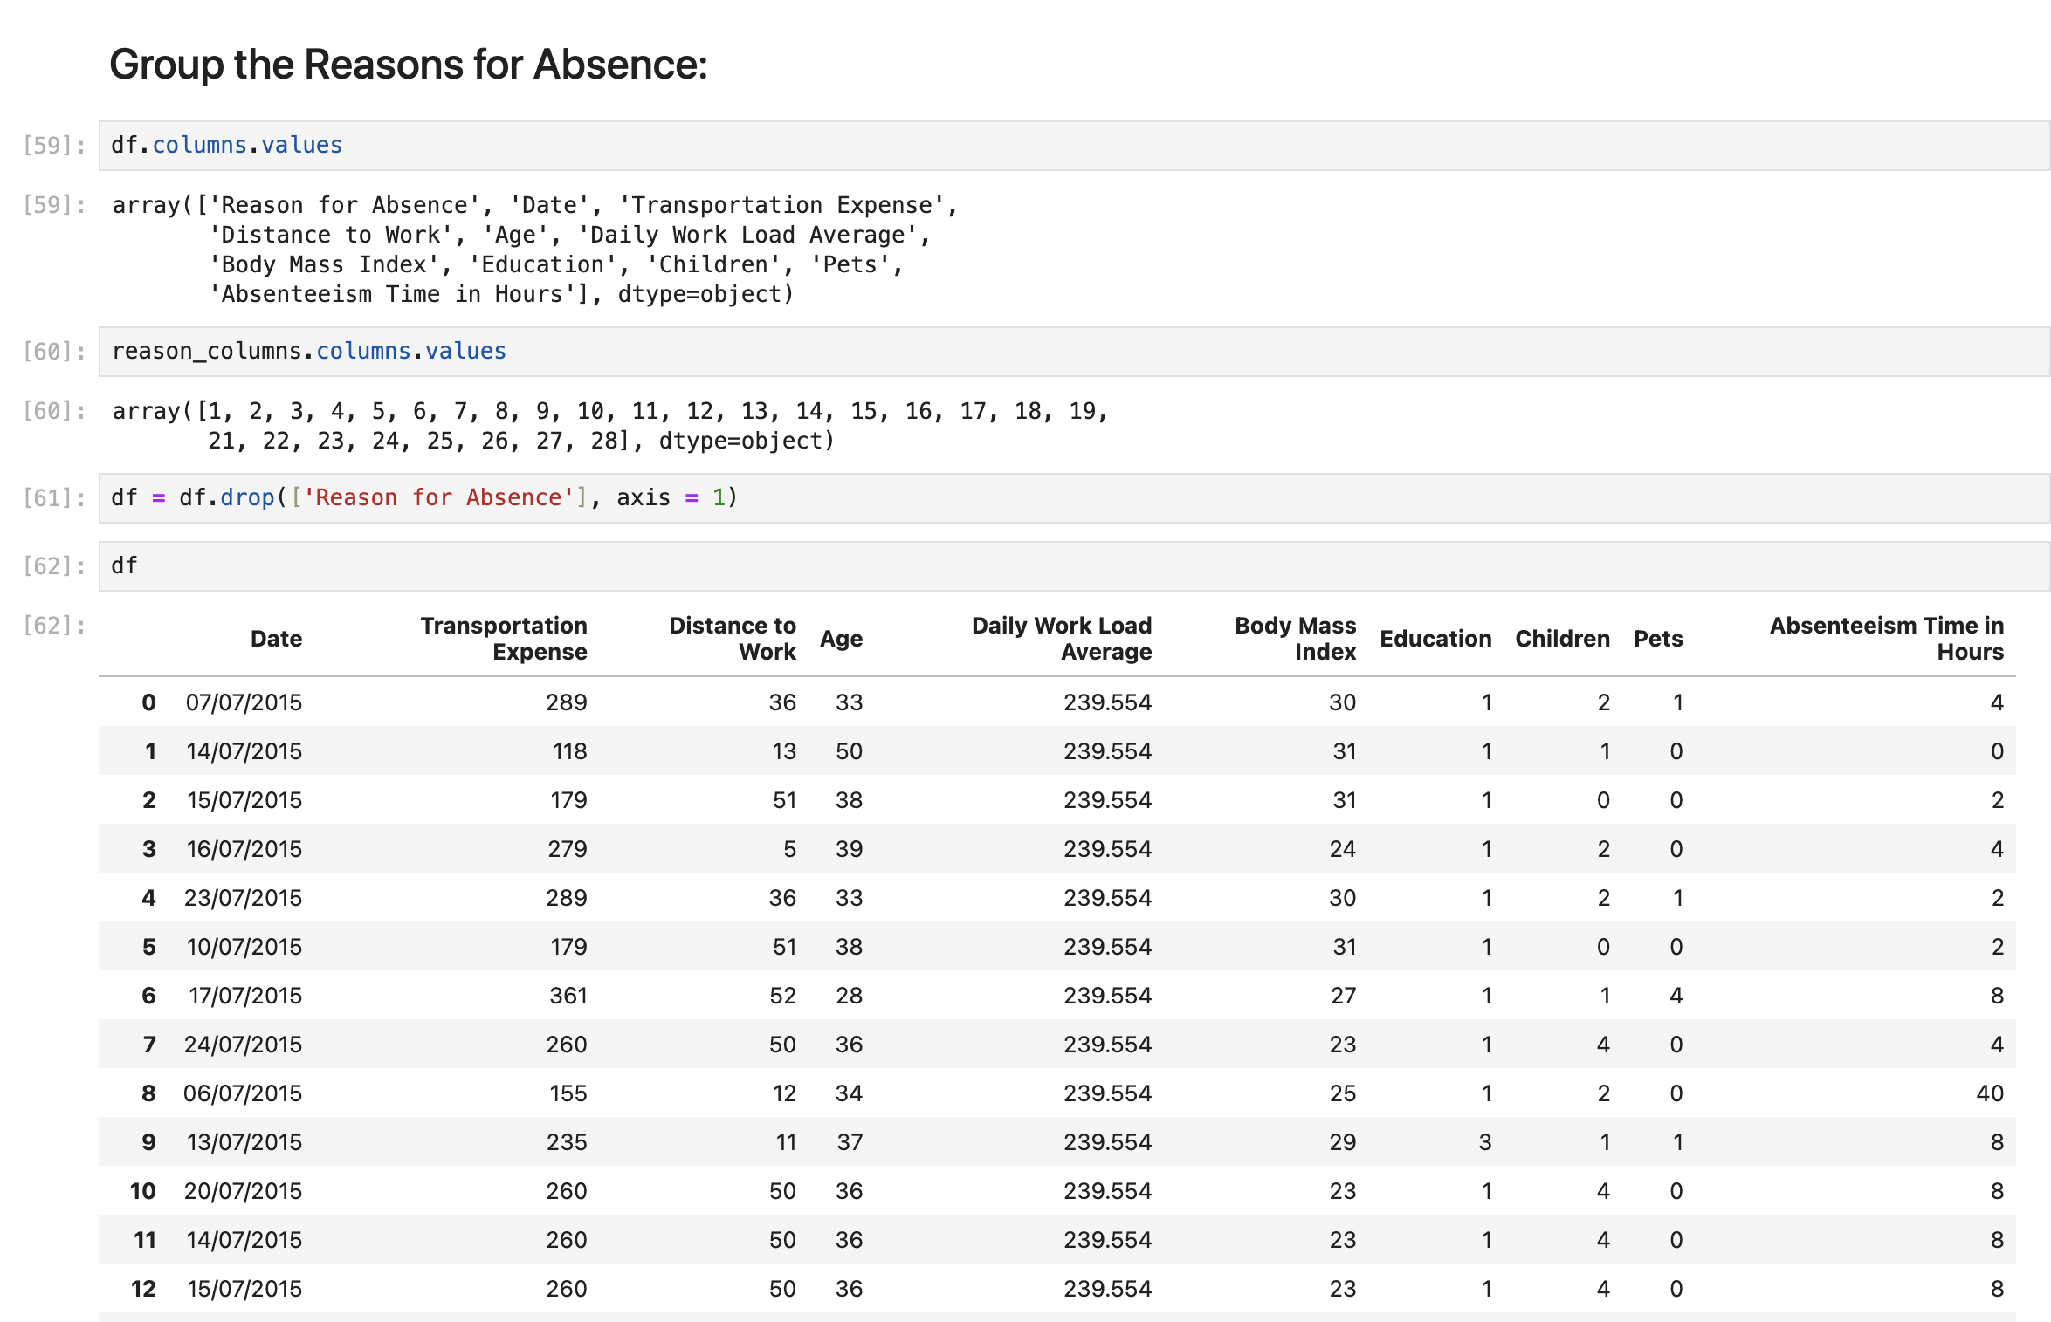
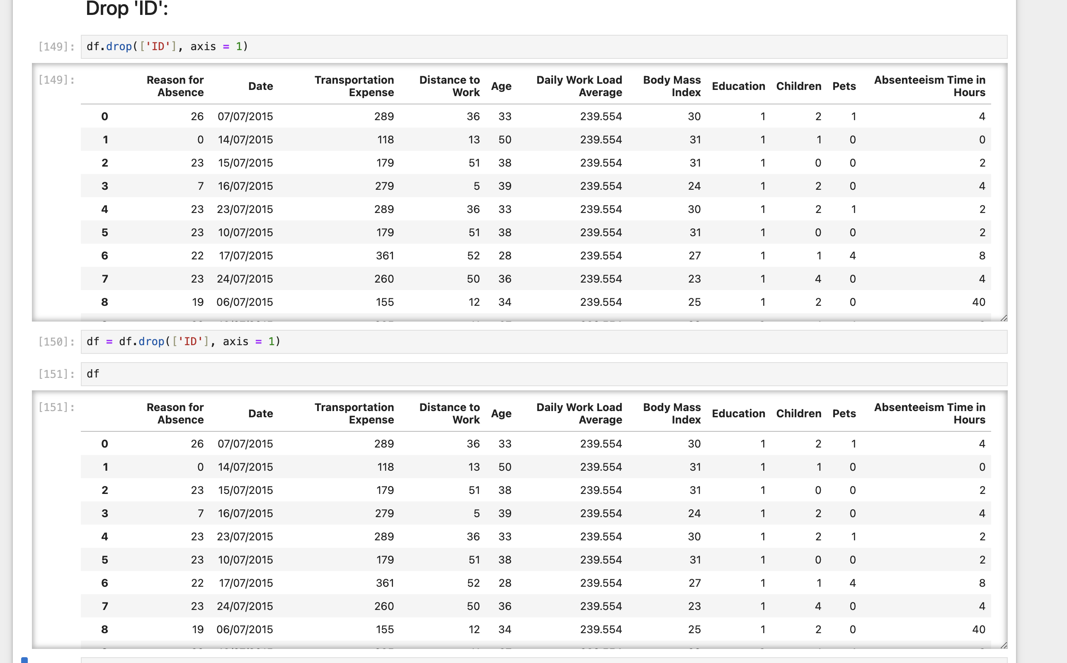
Continue…

Slide 7
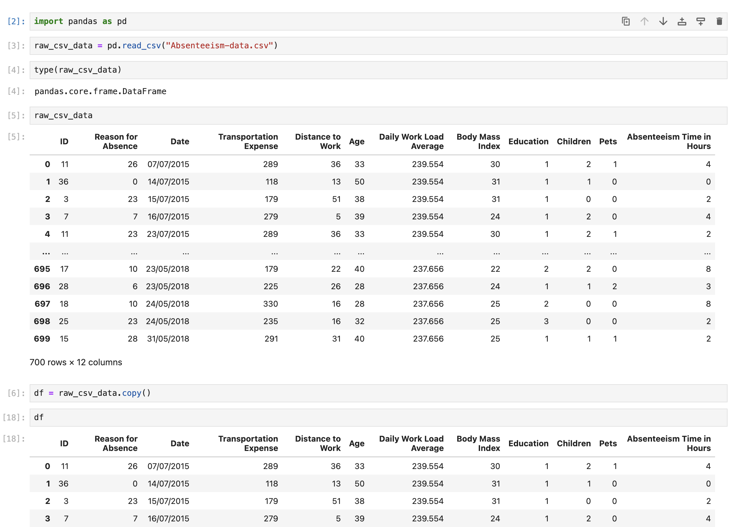
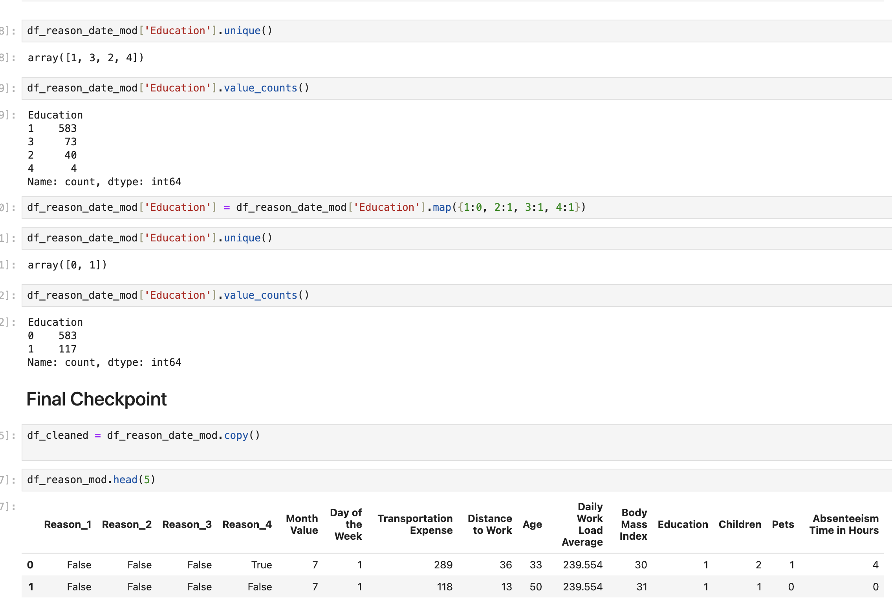
Continue…

Slide 8
Thanks☺
For more information, please visit
www.saranshgilhotra.ca/projects

